Slide 1
Logistic Regression

Slide 2
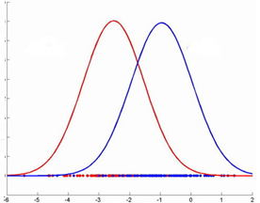

Logistic Regression Model -
A classification method built on the same concept as linear regression. The response variable is categorical. In it’s simplest form, the response variable is binary i.e. belongs to one class or the other
Given the value of predictor (variable x), the model estimates the probability that the new data point belongs to a given class say “A”. Probability values can range between 0 and 1.
Class B
Class A
Class B
Class A
Density distribution

Slide 3
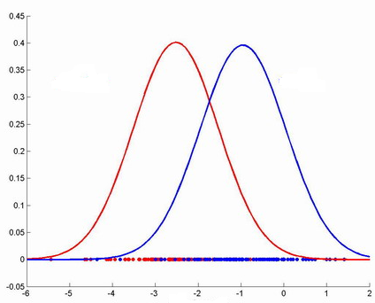
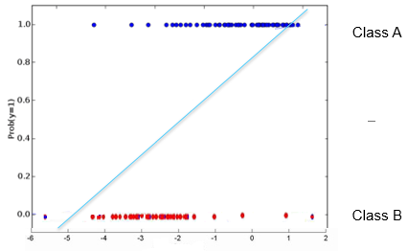
Logistic Regression Model
A new data point (shown with “?”) needs to be classified i.e. does it belong to class A or B.
Given the distribution, closer the point is to the origin, it is unlikely to belong to class A. Farther away it is from the origin, likely it belongs to class A
One can try to fit a simple linear model (y = mx +c) where y greater than a threshold means point most probably belongs to class A. The challenge is, for extreme values of x, probability is <0 or >1 which is absurd
Probability model

Slide 4
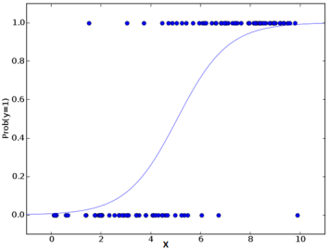
Logistic Regression Model -
The linear model is passed to a logistic function p = 1/ 1 + e^-t the result of which is values between 0 and 1. Thus p represents probability a data point belongs to class “A” given x
Class A
Class B
Note: The linear model t (which is of the form mx + c), represents logit which is natural log(p / 1-p) where p is probability that a data point belongs to a class or not

Slide 5
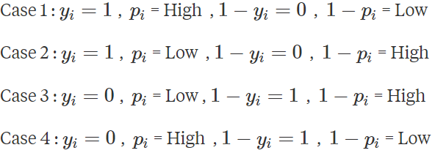
Logistic Regression Model -
Uses logloss function to find the best fit line from the infinite possibilities where
The objective is to make logLoss as large negative number as possible
There can be four difference cases for the value of yi and pi
Incorrect classification contributes very minimal to the sum while a correct classification contributes large magnitudes
Correct classification
Incorrect classification
Correct classification
Incorrect classification

Slide 6
Logistic Regression Model -
In case1 y = 1 and p = high implies that we have got things right!. It significantly inflates the sum because, Yi * log (Pi) would be high while the other term in the would be zero since 1 - Yi = 1 - 1 = 0.
So more occurrences of Case 1 would inflate the sum and consequently inflate the mean
4
1
Class A
2
3
Class B
In case2, y = 1 and p is low which is incorrect classification. p = low, Yi * log (Pi) would not inflate the sum as much, the second term would be zero since 1- yi would be zero. So Case 2 would ultimately not affect the sum a lot.
Similarly the occurrences of Case 3 would inflate the sum significantly because first term would be 0 but second term will be high i.e. (1- yi)* log(1 – pi)
Case 4 first term will be 0 while in second term due to high pi, (1 – pi) will also be small hence contribution will be small

Slide 7
Logistic Regression Model -
More of Case 1s and Case 3s increase the magnitude of the sum inside the logloss formula and because of the negative sign, make it overall error smaller and smaller
More Case2s and Case4s will not have as bit an impact on the overall value
The objective is to find the logistic curve that makes the overall logloss as negative as possible
4
1
Class A
2
3
Class B

Slide 8
Logistic Regression Model -
Advantages -
Makes no assumptions about distributions of classes in feature space
Easily extended to multiple classes (multinomial regression)
Natural probabilistic view of class predictions
Quick to train
Very fast at classifying unknown records
Good accuracy for many simple data sets
Resistant to overfitting
Can interpret model coefficients as indicators of feature importance
Dis advantages -
Constructs linear boundaries

Slide 9
Logistic Regression Model -
Lab- 2- Predict diabetes among Pima Indians
Description – Sample data is available at https://archive.ics.uci.edu/ml/machine-learning-databases/pima-indians-diabetes/pima-indians-diabetes.names
The dataset has 9 attributes listed below
Number of times pregnant
Plasma glucose concentration a 2 hours in an oral glucose tolerance test
Diastolic blood pressure (mm Hg)
Triceps skin fold thickness (mm)
2-Hour serum insulin (mu U/ml)
Body mass index (weight in kg/(height in m)^2)
Diabetes pedigree function
Age (years)
Class variable (0 or 1)
Sol: Logistic Regression - Lima Diabetes.ipynb

Slide 10
Confusion Matrix -
A tool to assess the performance of a classification model such as logistic regression model
Of the 84 actual diabetes case, the model correctly classified only 46 as diabetic
Of the 147 non diabetic cases, the model correctly classified 134 as non-diabetic
13 cases who are normal but identified as diabetic are called Type 1 error
38 cases of diabetic patients identified as normal is Type II error
Total = 231 | Predicted 0 | Predicted 1 | Row Total
Actual 0 | 134 | 13 | 147
Actual 1 | 38 | 46 | 84
Col Total | 172 | 59 | 231

